Slide 1

Safeguarding Confidential Data:
The Ethics of Cybersecurity
October 11, 2021
David G. Ries – Clark Hill PLC
Alvin E. Mathews, Jr. - Ulmer & Berne LLP
© David G. Ries 2021. All rights reserved.

Slide 2


Duty to Safeguard
Cybersecurity 101
Current Threats
The Threat Landscape
David G. Ries
Clark Hill PLC
dries@clarkhill.com
Alvin E. Mathews, Jr.
Ulmer & Berne LLP
amathews@ulmer.com

Slide 3
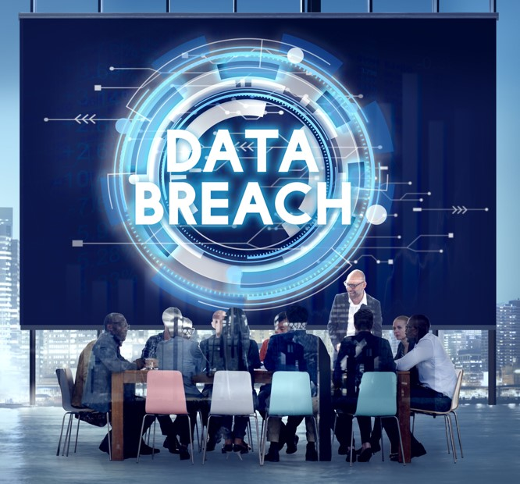
1. The Threat Landscape
Source: Shutterstock

Slide 4

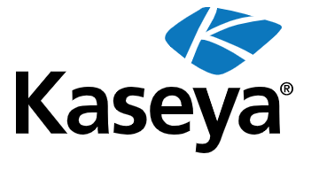
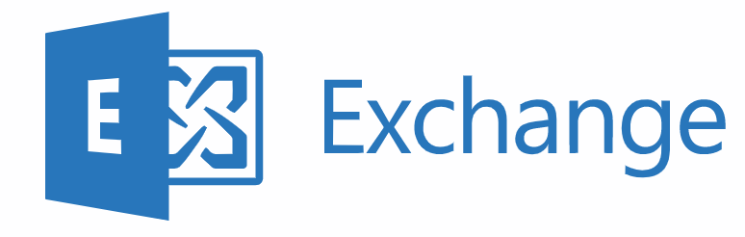
In the Headlines

Slide 5
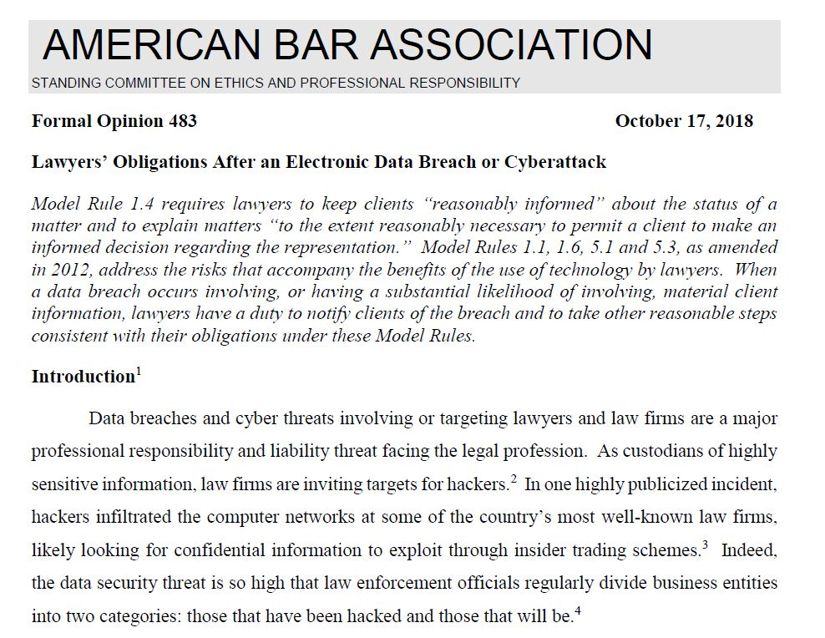
“Data breaches and cyber threats involving or targeting lawyers and law firms are a major professional responsibility and liability threat facing the legal profession. As custodians of highly sensitive information, law firms are inviting targets for hackers.
… Indeed, the data security threat is so high that law enforcement officials regularly divide business entities into two categories: those that have been hacked and those that will be.”
ABA Formal Opinion 483 (Oct. 2018)

Slide 6


Law Firms Are Targets!
Source: Animation Factory
“One Stop Shops”
High value data, well organized, often with weak security!

Slide 7
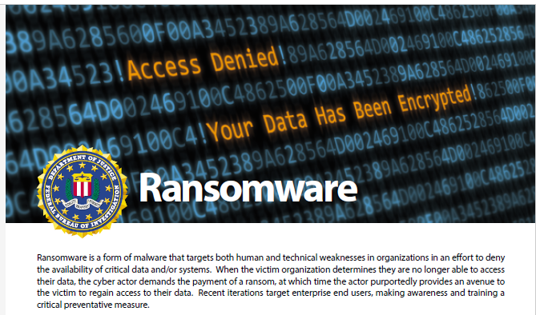

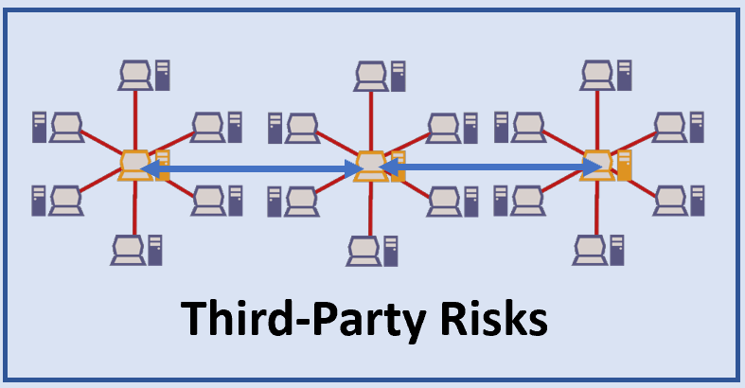
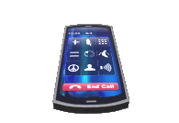
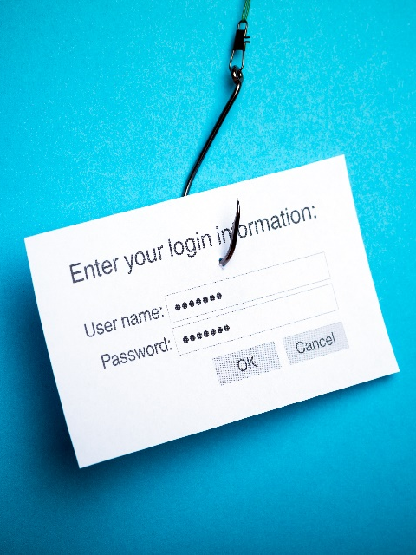
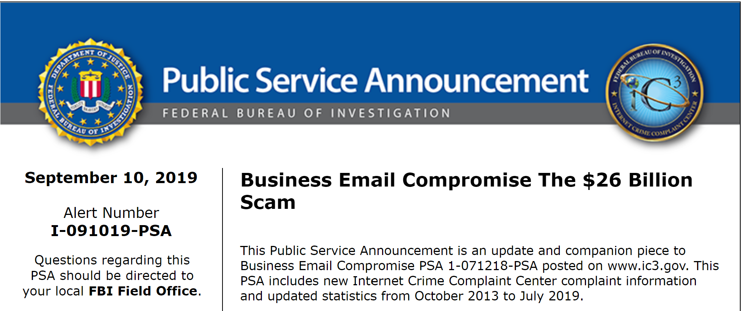
Greatest Threats to Law Firms
Source:
Animation
Factory
Lost & Stolen
Laptops
&
Mobile Devices
Business Email Compromise
Spearphishing
Source: Shutterstock
Source: Animation Factory

Slide 8
2. Duty To SAFEGUARD
Source: Shutterstock

Slide 9

Duty to Safeguard
Ethics Rules
Contracts
Laws and Regulations
Common Law

Slide 10
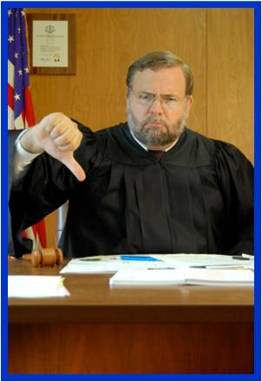
Breach of Duty
Contracts - Breach of Contract Action
Laws and Regulations - Enforcement Action
Common Law - Malpractice Action
Ethics Rules - Disciplinary Action
Source: iStock

Slide 11
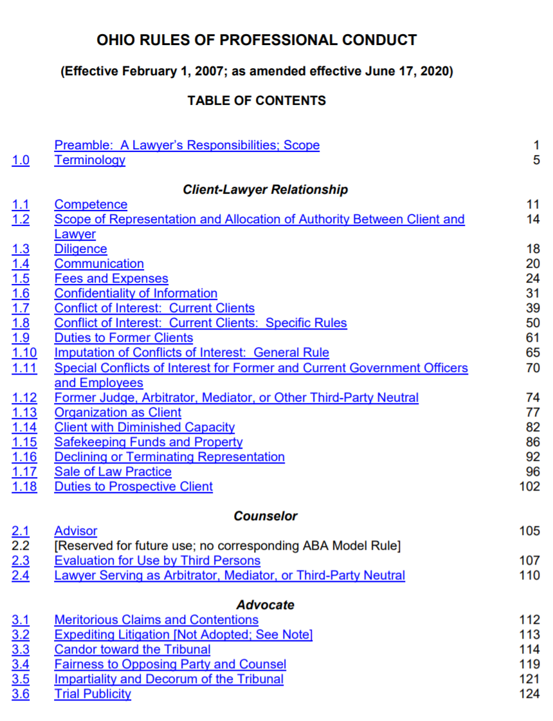
Key Ethics Rules
Rule 1.1 Competence
Rule 1.6 Confidentiality
Rules 5.1, Supervision
5.2 & 5.3
Rule 1.4 Communication

Slide 12
Rule 1.1 Competence
“…including the risks and benefits associated with relevant technology”

Slide 13
Rule 1.4 Communication
“reasonably consult with the client about the means by which the client’s objectives are to be accomplished”
“ informed consent”

Slide 14
Rule 1.6 Confidentiality
Reasonable Measures
Protect against:
- inadvertent disclosure
- unauthorized access

Slide 15
Supervision
Rule 5.1 – Partners, Managers and Supervisory Lawyers
Rule 5.2 – Subordinate Lawyer
Rule 5.3 – Nonlawyer Assistants

Slide 16
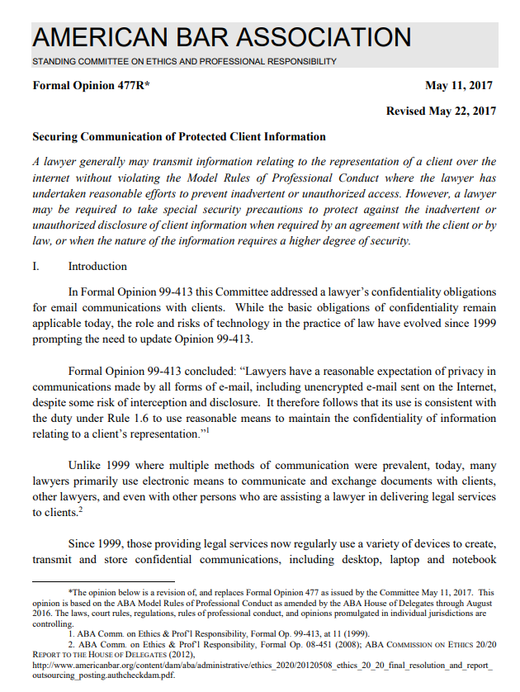
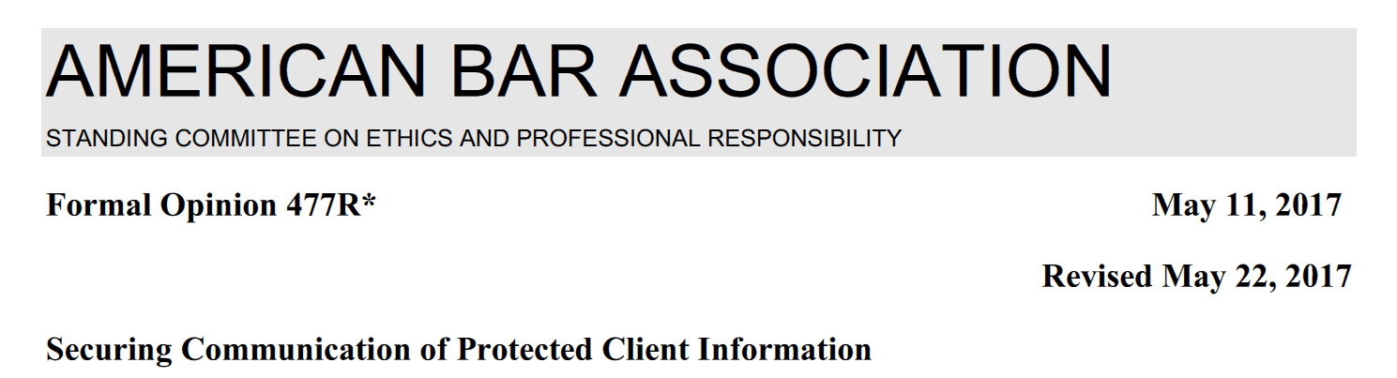

Slide 17
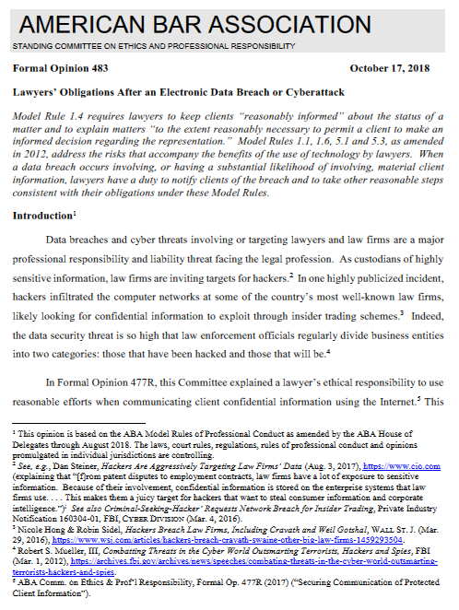
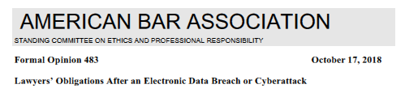

Slide 18
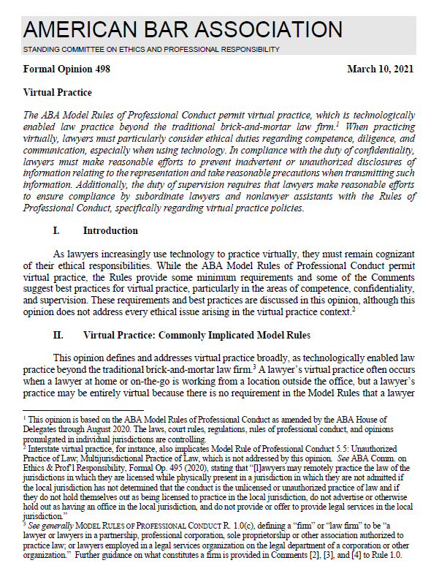
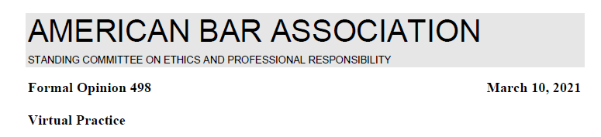

Slide 19
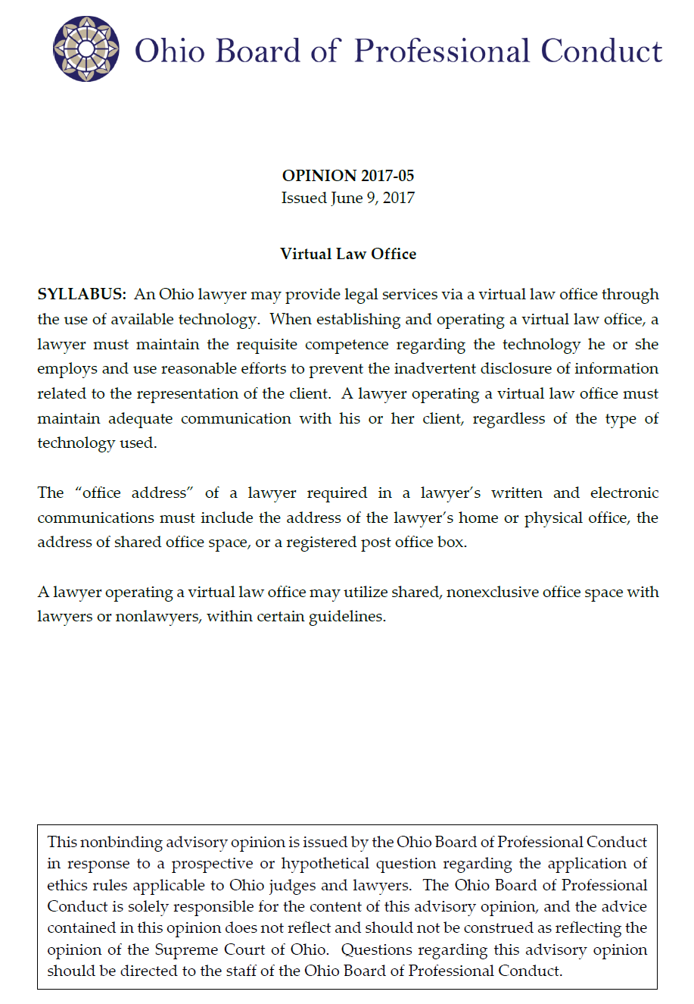
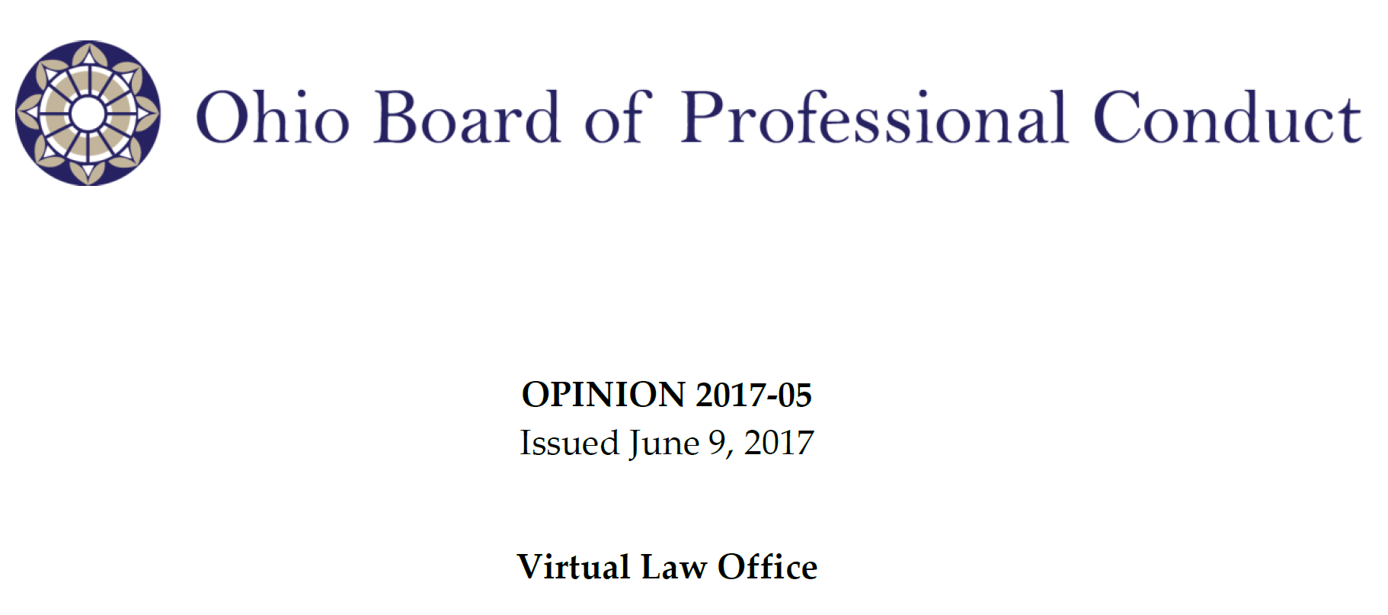

Slide 20

Competent and Reasonable Measures
Know it.
01
Learn it.
02
Get qualified help.
03
Qualified Consultant
Managed Service Provider (MSP)

Slide 21
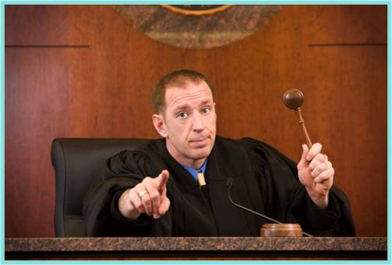
Laws and Regulations
Federal
Breach Notice
State
Breach Notice
Privacy
International
GDPR +
FTC Act
Reasonable Security
Reasonable Security
Source: iStock

Slide 22
3. Cybersecurity 101
Source: Shutterstock

Slide 23
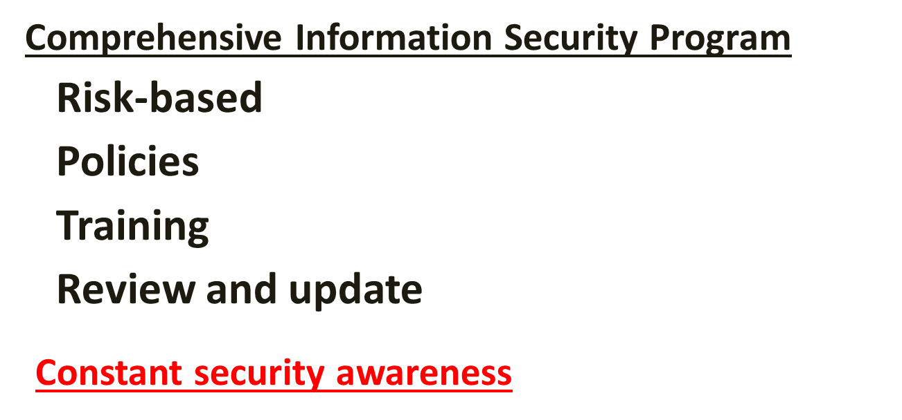
Comprehensive Cybersecurity Program

Slide 24
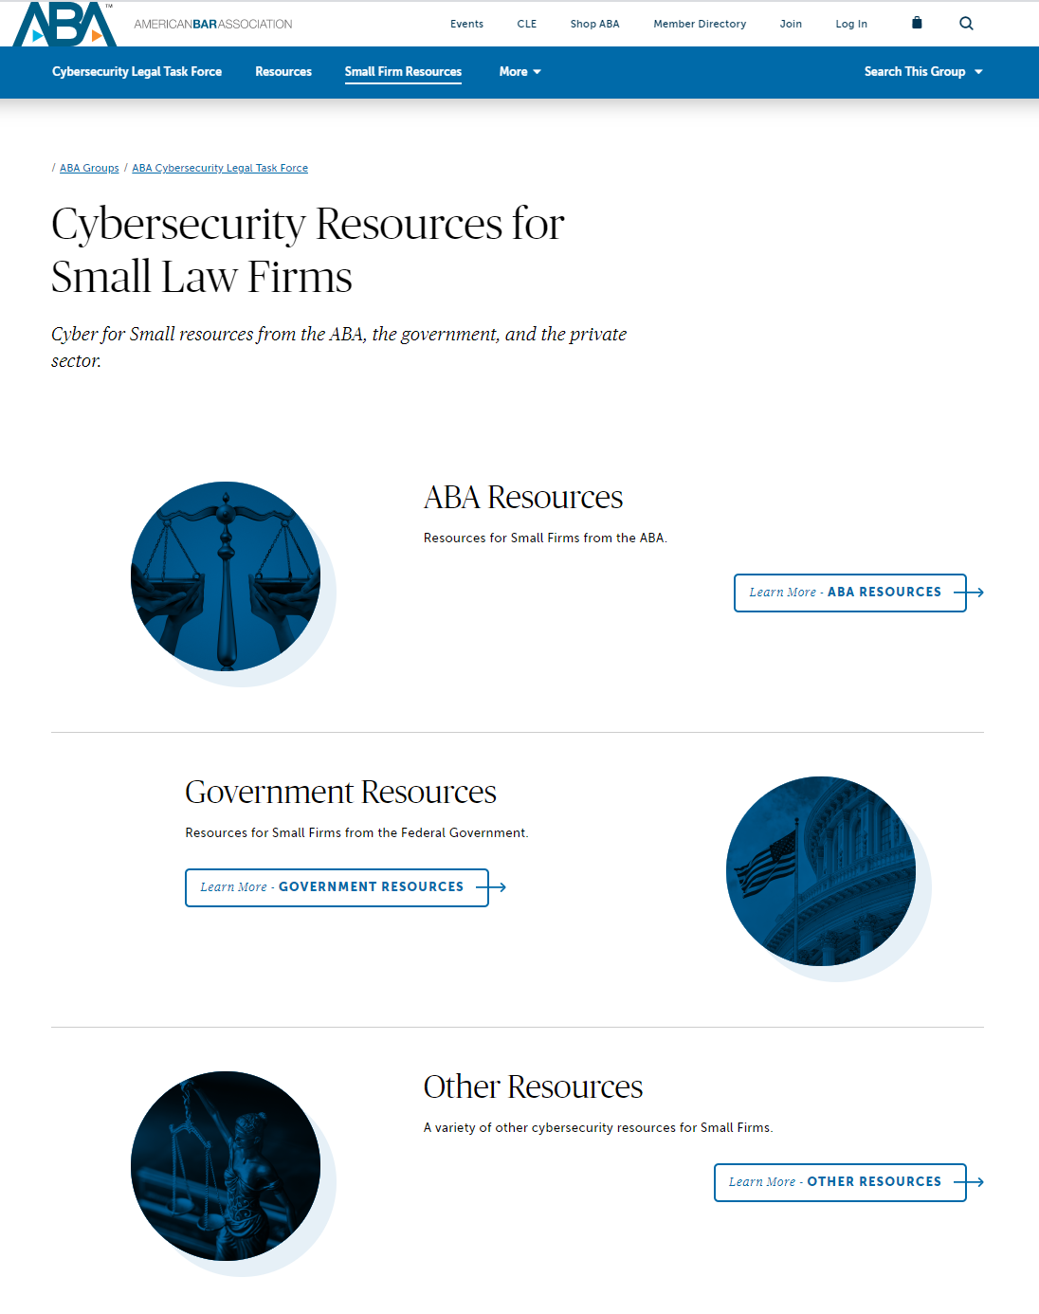
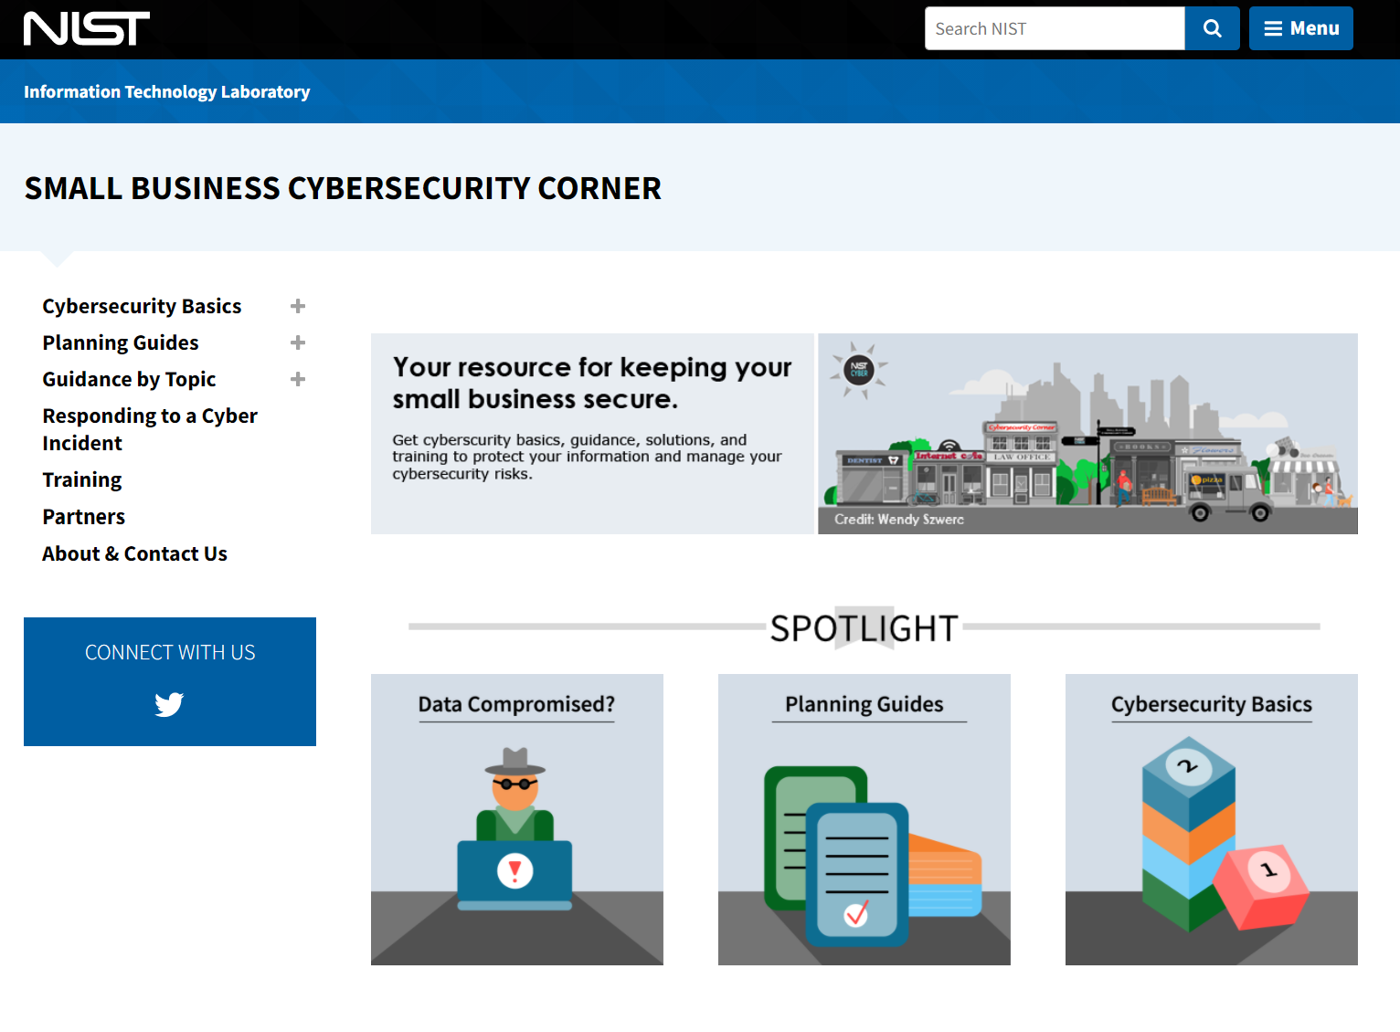
Small Firms

Slide 25
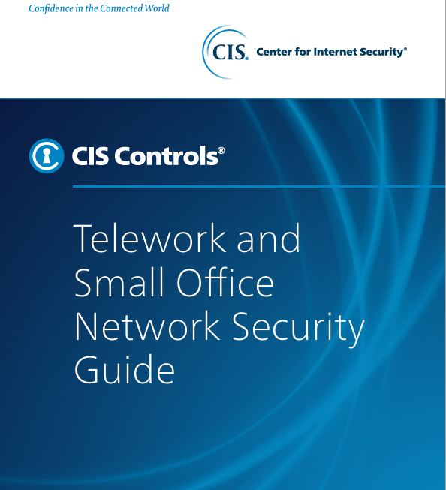
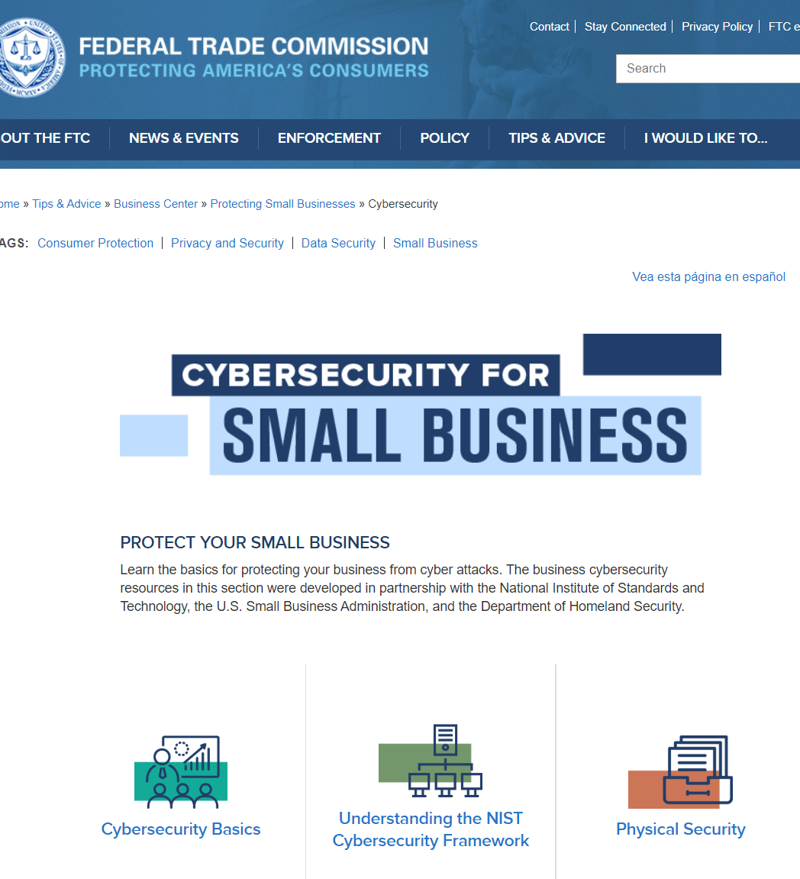
Small Firms

Slide 26
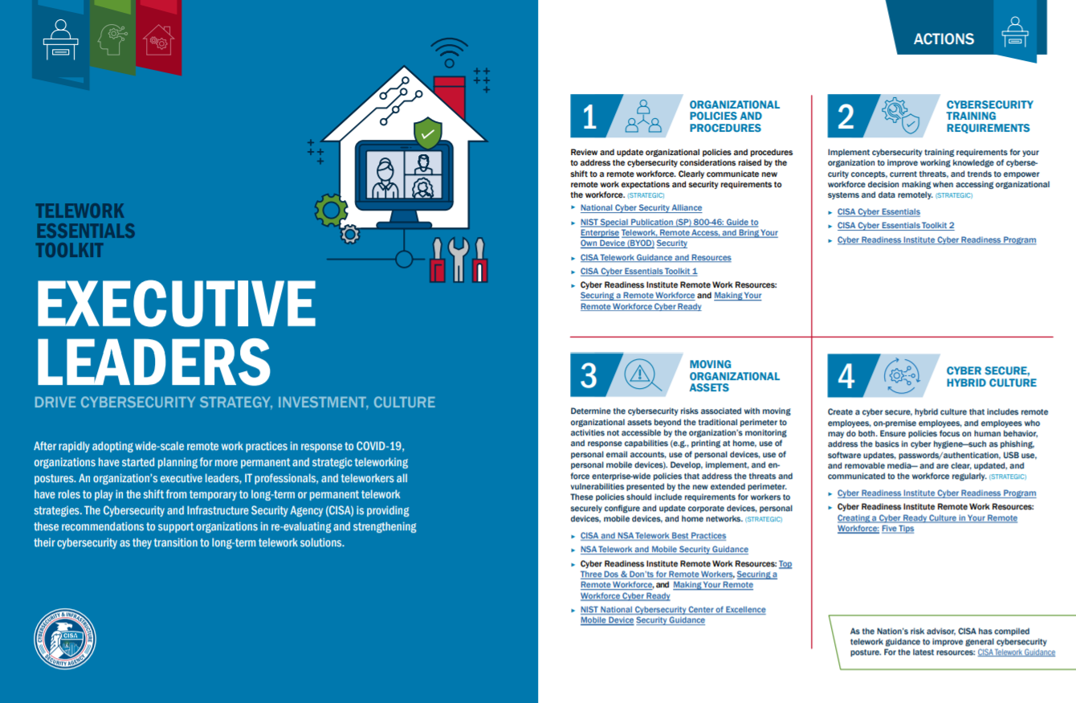
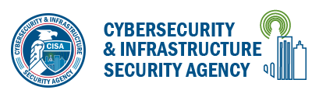
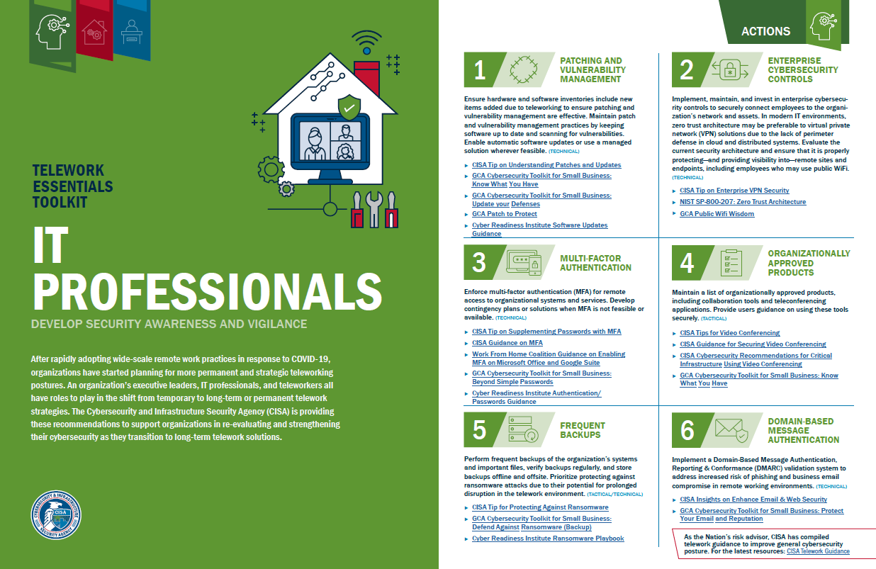
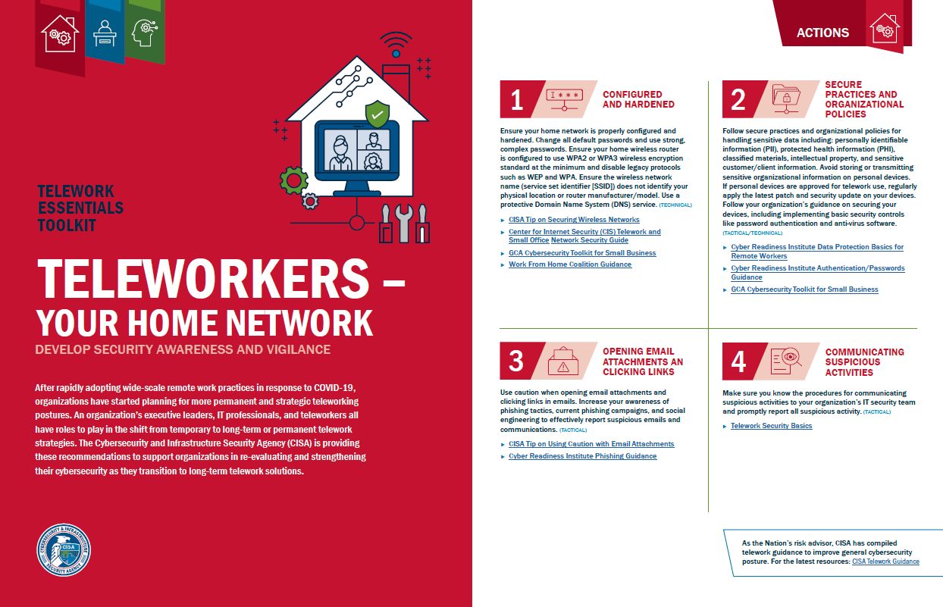
Telework Essentials Toolkit

Slide 27

Comprehensive Cybersecurity Program
Assignment of responsibility for security,
Manage and minimize data,
An inventory of information assets and data,
A risk assessment,
Appropriate administrative, technical and physical safeguards to address identified risks,
Manage new hires and current and departing personnel,
Training,
An incident response plan,
A backup and disaster recovery program,
Management of third-party security risks, and
Periodic review and updating.
Checklists

Slide 28
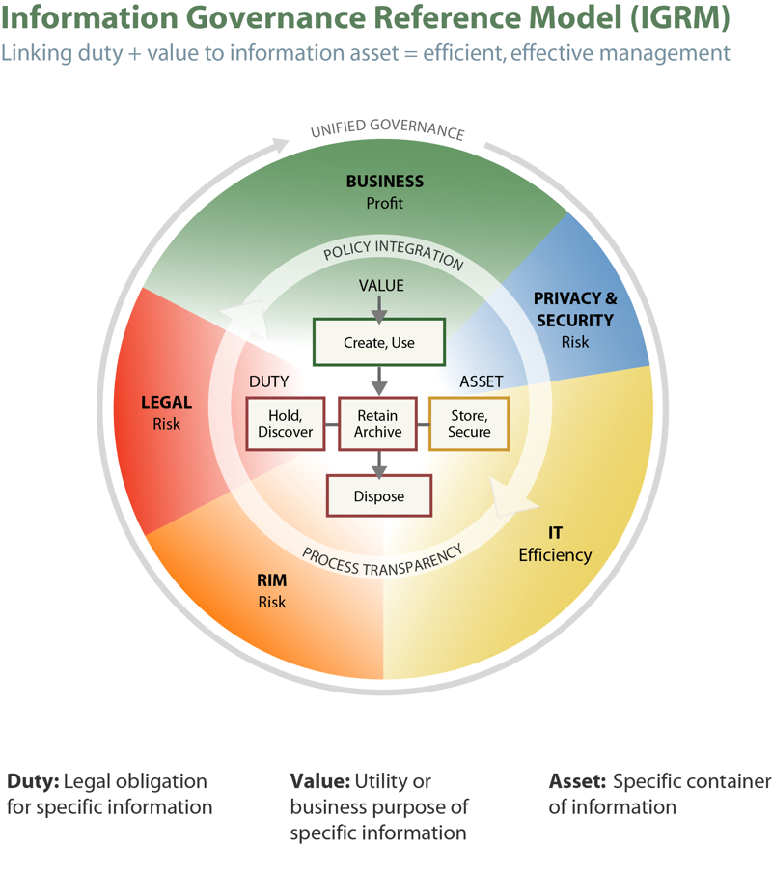
Manage and Minimize Data
Inventory of Technology and Data
– Data Map
Classify Data
Minimize Collection and Retention
Secure Disposal

Slide 29

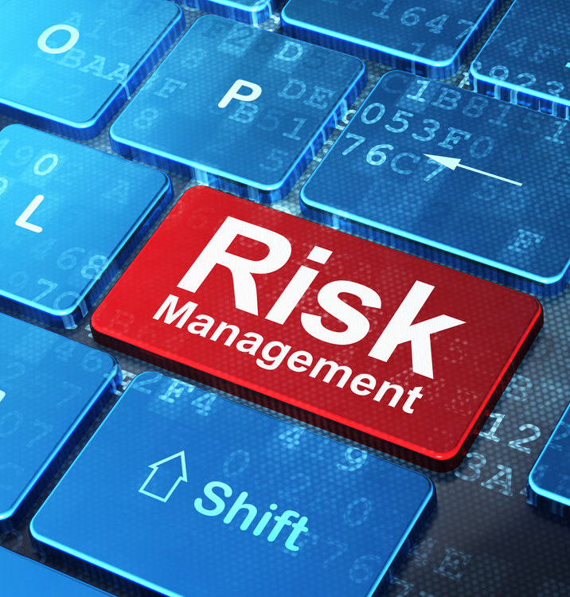
Risk Management Process
Assess the risks.
Manage the risks:
  Eliminate the risk.
  Control the risk with appropriate administrative, technical and physical safeguards.
  Transfer the risk
  (insurance, indemnity, etc.).
  Accept the risk.
Often a combination of approaches.
Source: Shutterstock

Slide 30

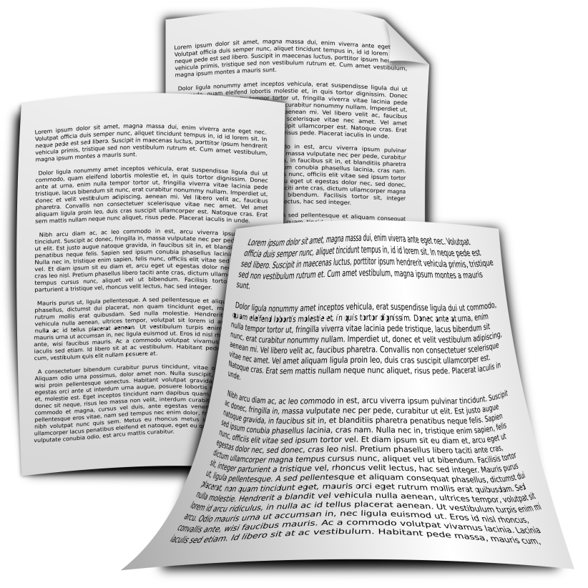

Cyber Insurance
Cyber
Policy
Application
Source: Shutterstock

Slide 31

Incident Response Plans
Preparing for when a law firm will be breached,
not if it may be breached
The new mantra in security:
Identify & Protect + Detect, Respond & Recover
Source: Shutterstock
Notes:
Gartner: “…by 2020, 60% of enterprise security budgets will be allocated to rapid response and detection - up from less than 10% in 2014.”

Slide 32
Practical Cybersecurity
Role-Based Access Control
Principal of Least Privilege
Account Management
Network Segmentation
Patching and Vulnerability Management
Spam Filtering and Website Filtering
Use Common, Secure Configurations
Security Software (up to date)
Encryption
Controlling Downloads & Uploads
Password Management
Multi-Factor Authentication
Consider (secure) Cloud Services
Backup and Disaster Recovery
Training + Constant Security Awareness
Checklists

Slide 33
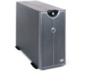
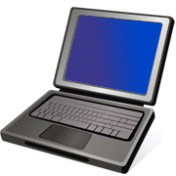

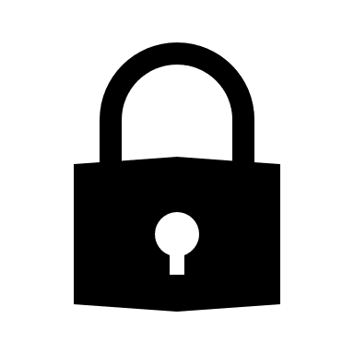
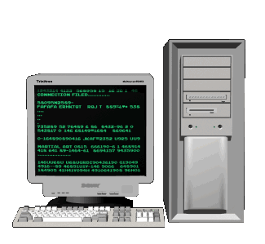
Work-at-Home / Remote Access
Internet
Law Firm Network
VPN
Remote User
Security of Endpoint
Security of Network
Secure Internet Connection
Printer Security
Paper Security
Physical Security
BYOD / Home Computers
Secure Connection
Strong Authentication /
Access Control (MFA)
Close Unneeded Ports
Auto Log-off
Segmentation
Enable and Retain Logs
Standard Network and
Physical Security

Slide 34

Remote Access
Internet
Cloud Services
VPN
Remote User
Security of Endpoint
Security of Network
Secure Internet Connection
Printer Security
Paper Security
Physical Security
BYOD / Home Computers
Secure Connection
Strong Authentication /
Access Control (MFA)
Secure Configuration
Auto Log-off
Enable and Retain Logs
Encryption
Backup

Slide 35

Selecting a Cloud Service Provider
Compliance with Ethical Obligations
Due Diligence
Contract / Terms of Service
Where is Data Stored?
Who Has the Encryption Keys?
Who Owns the Data?
Response to Government Request / Subpoena
Backup and Business Continuity
Recovering Data
Source: Shutterstock

Slide 36

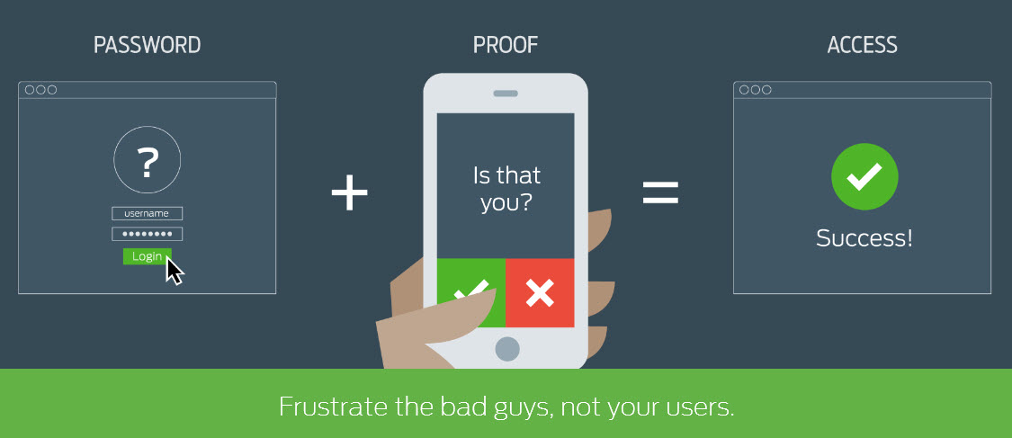
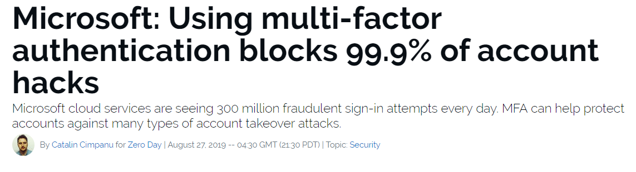
Authentication
- Strong Passwords or Passphrases
- Multifactor Authentication
- Password Manager
Duo Security
ZDNet
March 6, 2020

Slide 37
- Access Control
- Segmentation
Access

Slide 38
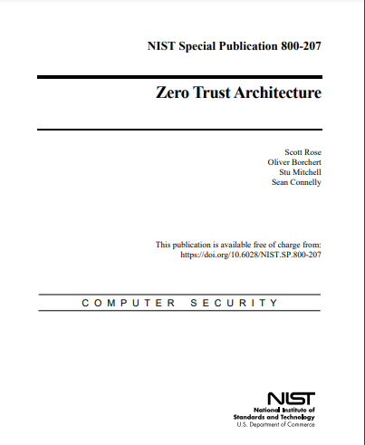
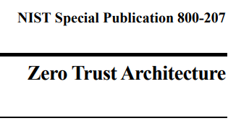
Zero Trust
Aug. 2020

Slide 39
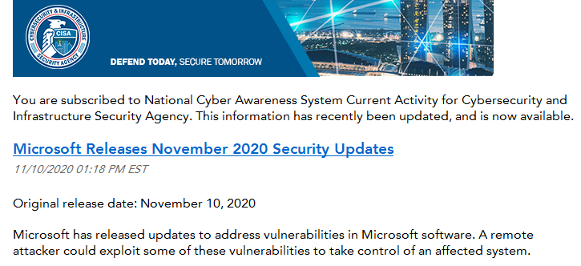
Stay Current!
Current operating system – with all updates
Current applications and add-ons – with all updates
Current firmware
Enable auto updates
39

Slide 40
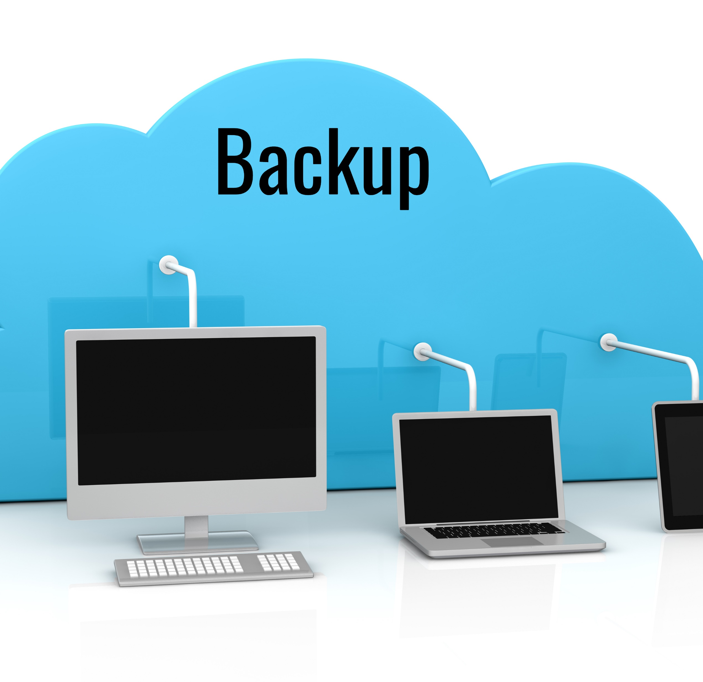
Backups
Regular backups
Test backups regularly!
Offline backups
Work-from-home issues
Cloud backups
  Do NOT assume cloud providers backup your data
Source: Shutterstock

Slide 41
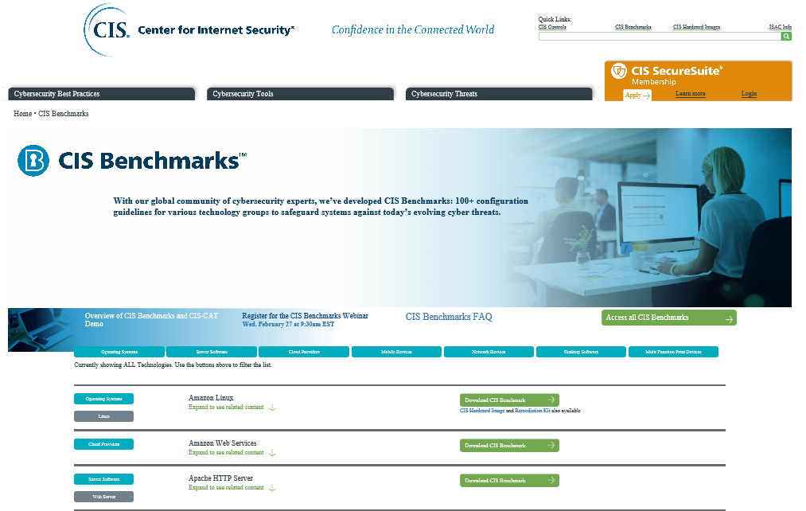
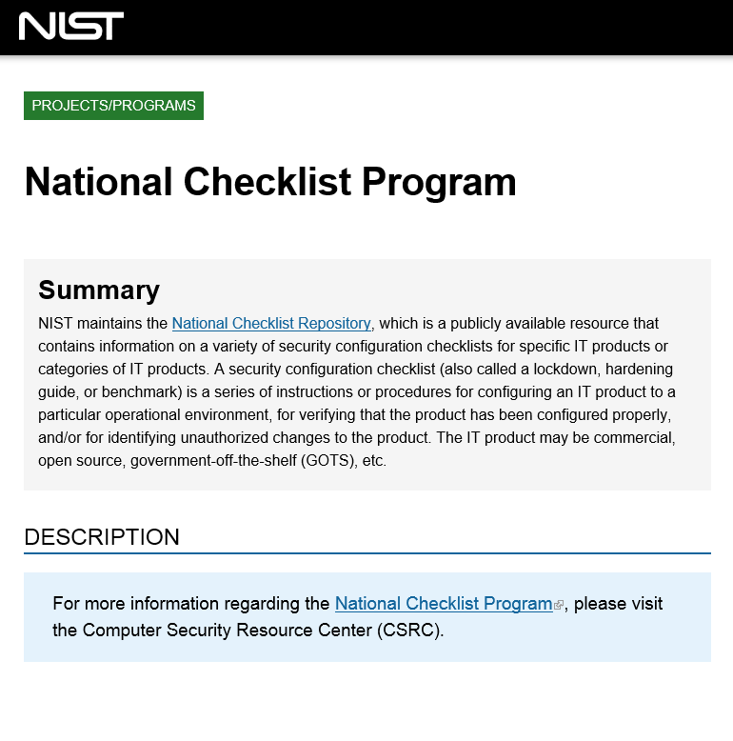
Use Common, Secure Configurations
Follow set up instructions
Set up administrator and standard user accounts
Use a strong password / passphrase
Set up auto lock after x mins of inactivity
Set up lock after x incorrect log on attempts
Enable encryption (+ save recovery key)
Turn on firewall
Use current operating system and apps
- with all current updates
Install security software (auto update)
Secure Internet browser
Turn off unneeded services
Checklists

Slide 42
4. current threats
Source: Shutterstock

Slide 43

Original:
Encrypts data
Demands ransom for decryption key
Newer variants:
Encrypt data
Exfiltrate data
Demand ransom
  - for decryption key
  - to prevent sale/disclosure of data
Delete backups
Disable security and backup apps
Steal credentials
Escalate privilege
Move through networks
Maintain persistence
Source: Shutterstock

Slide 44
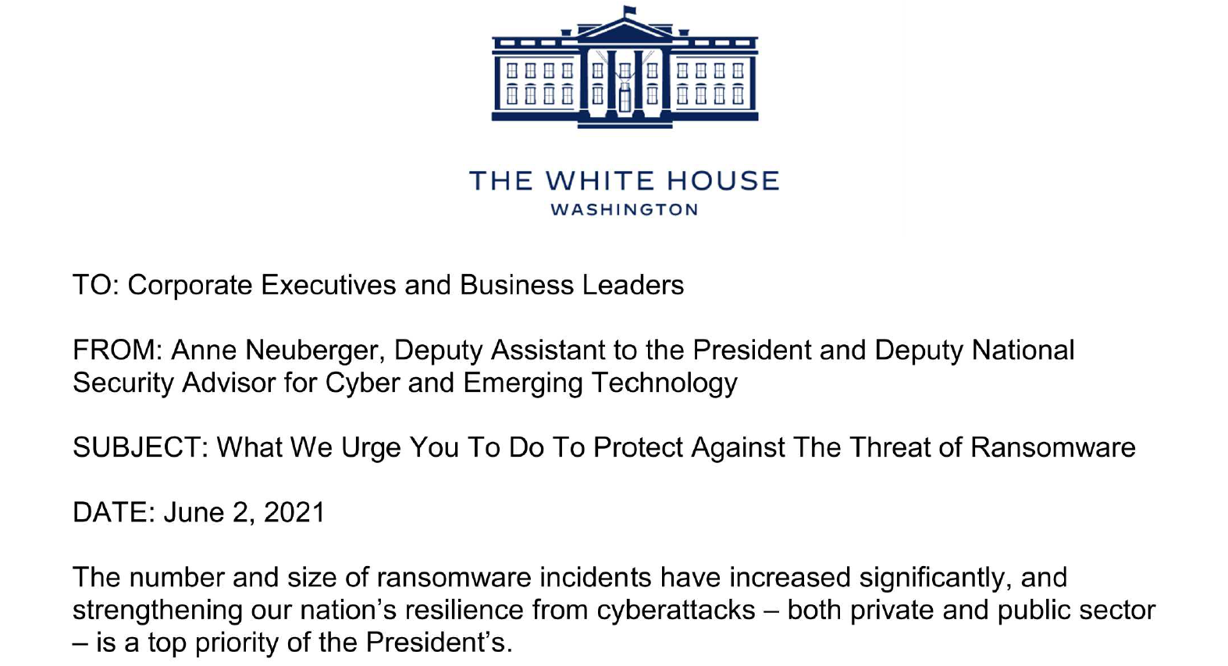
2. Backup your data, system images, and configurations frequently, regularly test them, and keep the backups offline.
3. Update and patch operating systems, applications, and firmware as soon as possible and maintain the process consistently.
4. Test your Incident Response Plan ( if you do not have one – develop a plan with urgency).
5. Test your systems and environments for vulnerabilities and gaps. Ask your partners and vendors to do the same.
6. Segment your Networks and Data.
1. Immediately implement the best practices.

Slide 45
1. Immediately implement the best practices:
- multifactor authentication (because passwords alone are routinely compromised),
- endpoint detection & response system (to hunt for malicious activity on a network and block it)
- encrypt all data, at rest and in use (so if data is stolen, it is unusable)
- develop or seek a skilled, empowered security team (to patch rapidly, and share and incorporate threat information in your defenses)

Slide 46

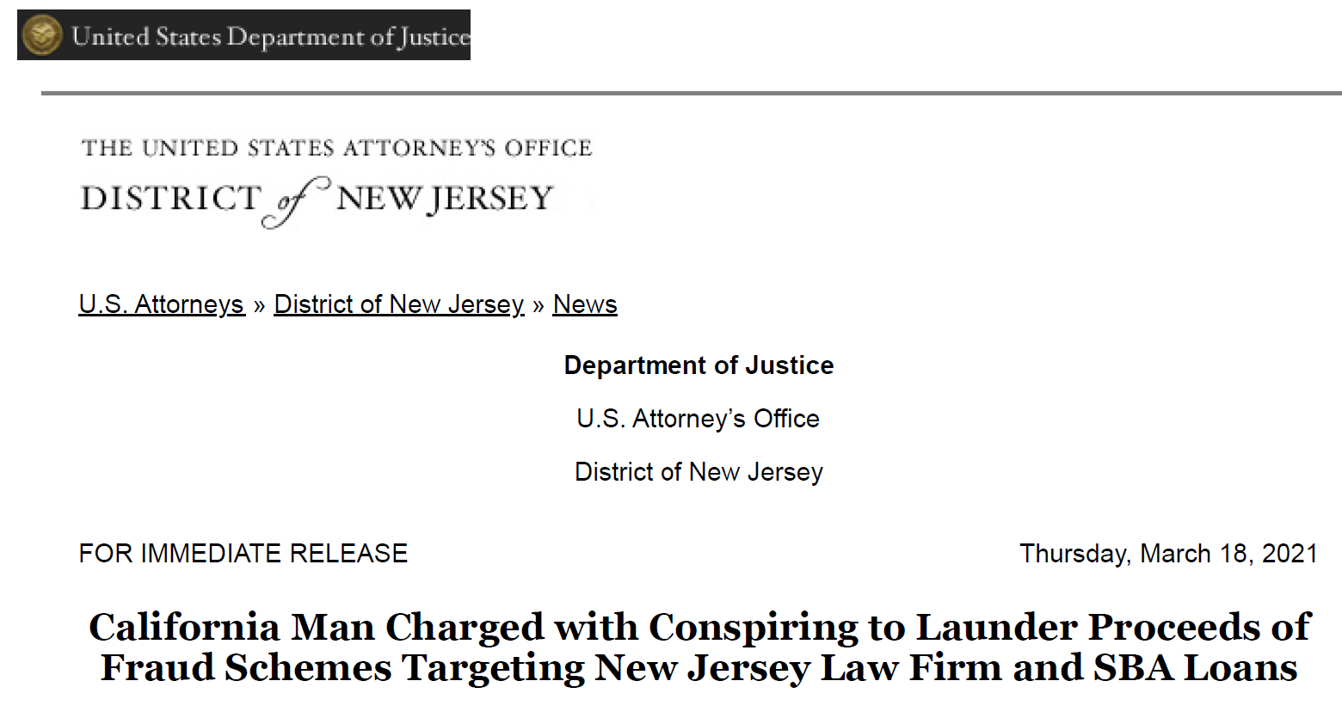
Business Email Compromise
Uses spearphishing or a compromised e-mail account:
Get logon credentials
/ bank account info
Steal information
Direct a fraudulent payment

Slide 47
FBI: Protecting against BEC
Be careful with what information you share online or on social media.
Don’t click on anything in an unsolicited email or text message asking you to update or verify account information.
Carefully examine the email address, URL, and spelling used in any correspondence. Scammers use slight differences to trick your eye and gain your trust.
Be careful what you download. Never open an email attachment from someone you don't know, and be wary of email attachments forwarded to you.
Set up two-factor (or multi-factor) authentication on any account that allows it, and never disable it.
Verify payment and purchase requests in person if possible or by calling the person to make sure it is legitimate.
Verify any change in account number or payment procedures with the person making the request.
Be especially wary if the requestor is pressing you to act quickly.

Slide 48
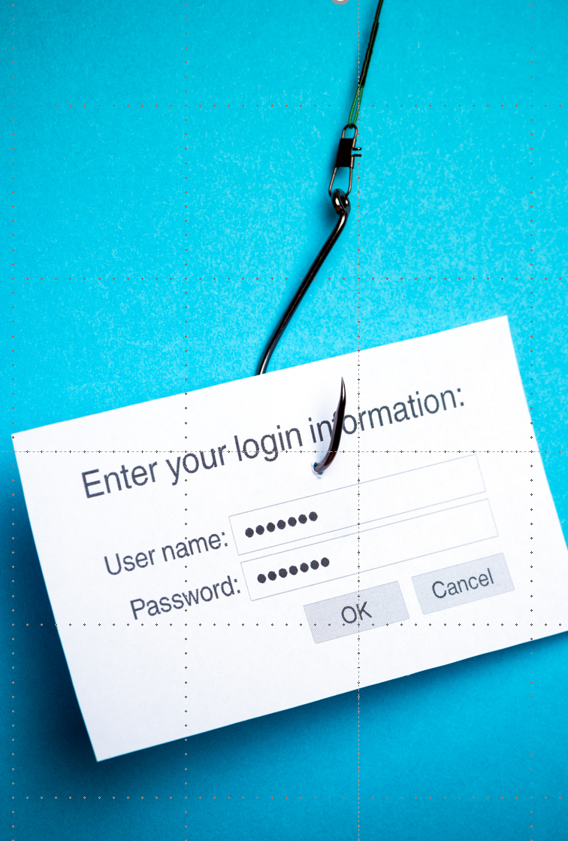
Phishing / Spearphishing
Click
Click on a link
Open
Open an attachment
Visit
Visit a malicious website
Enter
Enter information
Send
Send information or money
Source: Shutterstock

Slide 49
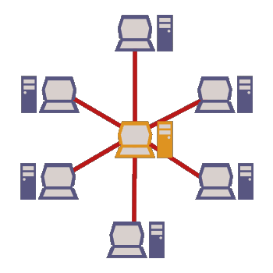
Third Party Risks
Clients
Co-counsel
Opposing counsel
Suppliers
Service providers
Bar groups
Courts
Client
Law
Firm
Service
Provider
+

Slide 50
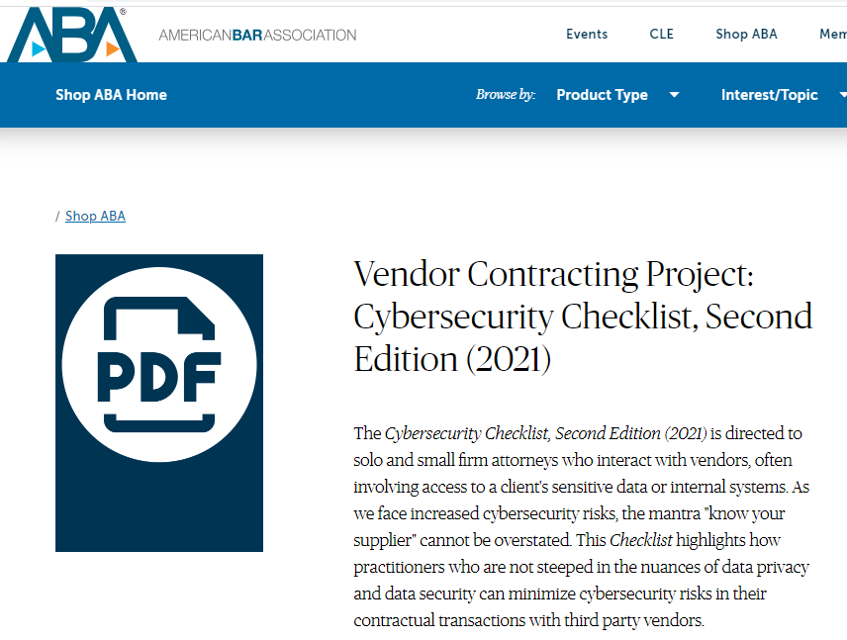
www.americanbar.org/products/ecd/ebk/411859099

Slide 51
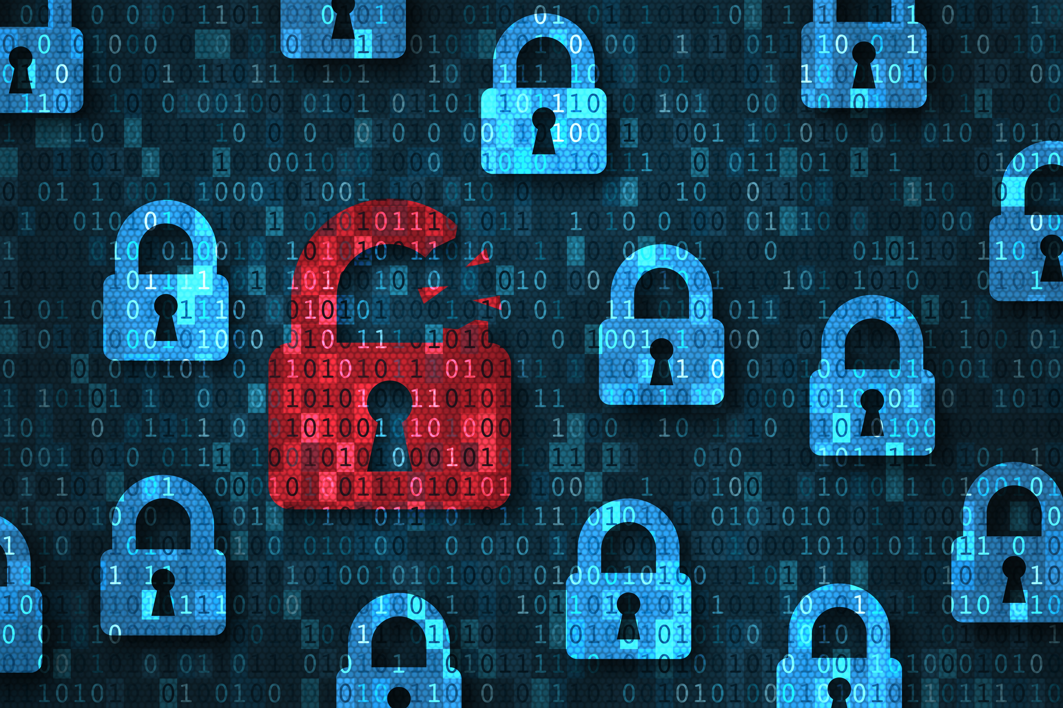
Encryption
Source:
Animation
Factory
Lost & Stolen
Laptops
&
Mobile Devices

Slide 52
Takeaways
1. Understand the ethical duty to take competent and reasonable measures to safeguard client information.
2. Prepare or update a comprehensive cybersecurity program.
3. Prepare or update an incident response plan.
4. Get qualified help if you need it.
5. Maintain constant cybersecurity awareness, by every user, every time they’re using technology.

Slide 53
Safeguarding Confidential Data:
The Ethics of Cybersecurity
Thanks for attending!
David G. Ries – Clark Hill PLC
Alvin E. Mathews, Jr. - Ulmer & Berne LLP

